Slide 1


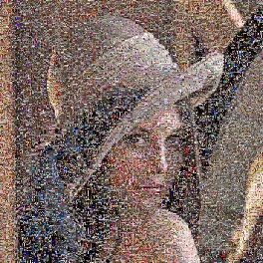
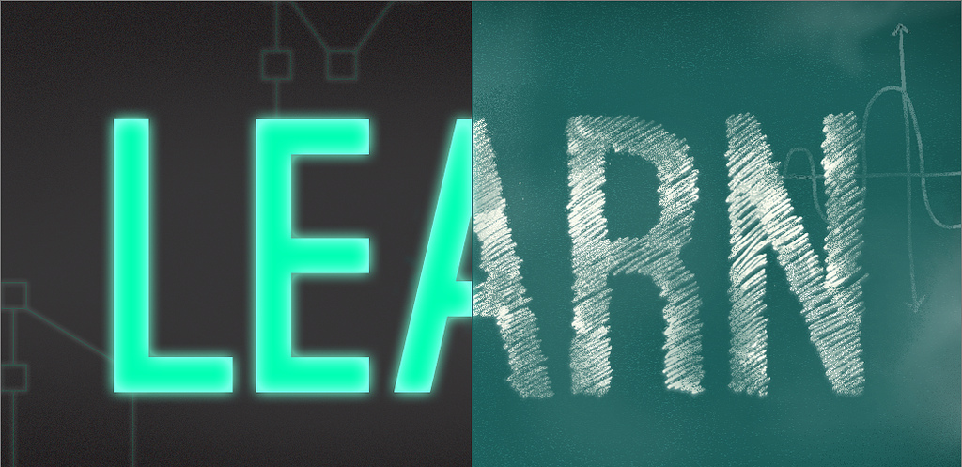
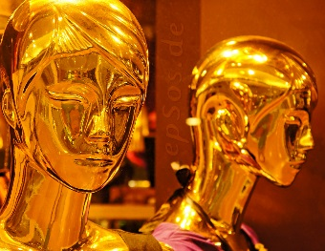

Pattern Recognition and Machine Learning Unsupervised Learning Matteo Tomei
Dipartimento di Ingegneria «Enzo Ferrari»,
Università di Modena e Reggio Emilia

Slide 2
What is Clustering?
Also called unsupervised learning, sometimes called classification by statisticians and sorting by psychologists and segmentation by people in marketing
Organizing data into classes such that there is
high intra-class similarity
low inter-class similarity
Finding the class labels and the number of classes directly from the data (in contrast to classification).
More informally, finding natural groupings among objects.

Slide 3
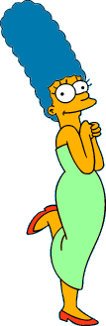



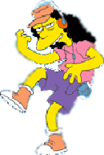



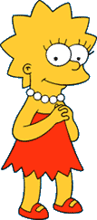
What is a natural grouping among these objects?

Slide 4





What is a natural grouping among these objects?
Clustering is subjective
Simpson's Family
School Employees
Females
Males

Slide 5
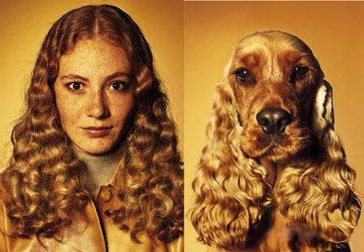
What is Similarity?
The quality or state of being similar; likeness; resemblance; as, a similarity of features.
Webster's Dictionary
Similarity is hard to define, but…
“We know it when we see it”
The real meaning of similarity is a philosophical question. We will take a more pragmatic approach.

Slide 6
Intuitions behind desirable distance measure properties
D(A,B) = D(B,A) Symmetry
Otherwise you could claim “Alex looks like Bob, but Bob looks nothing like Alex.”
D(A,A) = 0 Constancy of Self-Similarity
Otherwise you could claim “Alex looks more like Bob, than Bob does.”
D(A,B) = 0 IIf A=B Positivity (Separation)
Otherwise there are objects in your world that are different, but you cannot tell apart.
D(A,B) ≤ D(A,C) + D(B,C) Triangular Inequality
Otherwise you could claim “Alex is very like Bob, and Alex is very like Carl, but Bob is very unlike Carl.”

Slide 7


Two Types of Clustering
Partitional algorithms: Construct various partitions and then evaluate them by some criterion (we will see an example called BIRCH)
Hierarchical algorithms: Create a hierarchical decomposition of the set of objects using some criterion
Hierarchical
Partitional

Slide 8
Desirable Properties of a Clustering Algorithm
Scalability (in terms of both time and space)
Ability to deal with different data types
Minimal requirements for domain knowledge to determine input parameters
Able to deal with noise and outliers
Insensitive to order of input records
Incorporation of user-specified constraints
Interpretability and usability

Slide 9
(How-to) Hierarchical Clustering
The number of dendrograms with n leafs = (2n -3)!/[(2^{(n -2)}) (n -2)!]
Number Number of Possible
of Leafs Dendrograms
2 1
3 3
4 15
5 105
... …
34,459,425
Since we cannot test all possible trees we will have to heuristic search of all possible trees. We could do this..
Bottom-Up (agglomerative): Starting with each item in its own cluster, find the best pair to merge into a new cluster. Repeat until all clusters are fused together.
Top-Down (divisive): Starting with all the data in a single cluster, consider every possible way to divide the cluster into two. Choose the best division and recursively operate on both sides.

Slide 10


We begin with a distance matrix which contains the distances between every pair of objects in our database.
0
8
8
7
7
0
2
4
4
D( , ) = 8
D( , ) = 1
0
3
3
0
1
0

Slide 11

Bottom-Up (agglomerative): Starting with each item in its own cluster, find the best pair to merge into a new cluster. Repeat until all clusters are fused together.
Consider all possible merges…
Choose the best
…

Slide 12
Bottom-Up (agglomerative): Starting with each item in its own cluster, find the best pair to merge into a new cluster. Repeat until all clusters are fused together.
Consider all possible merges…
Choose the best
…
Consider all possible merges…
Choose the best
…

Slide 13
Bottom-Up (agglomerative): Starting with each item in its own cluster, find the best pair to merge into a new cluster. Repeat until all clusters are fused together.
Consider all possible merges…
Choose the best
…
Consider all possible merges…
Choose the best
…
Consider all possible merges…
Choose the best
…

Slide 14

Bottom-Up (agglomerative): Starting with each item in its own cluster, find the best pair to merge into a new cluster. Repeat until all clusters are fused together.
Consider all possible merges…
Choose the best
…
Consider all possible merges…
Choose the best
…
Consider all possible merges…
Choose the best
…

Slide 15
We know how to measure the distance between two objects, but defining the distance between an object and a cluster, or defining the distance between two clusters is non obvious.
Single linkage (nearest neighbor): In this method the distance between two clusters is determined by the distance of the two closest objects (nearest neighbors) in the different clusters.
Complete linkage (furthest neighbor): In this method, the distances between clusters are determined by the greatest distance between any two objects in the different clusters (i.e., by the "furthest neighbors").
Group average linkage: In this method, the distance between two clusters is calculated as the average distance between all pairs of objects in the two different clusters.
Wards Linkage: In this method, we try to minimize the variance of the merged clusters

Slide 16
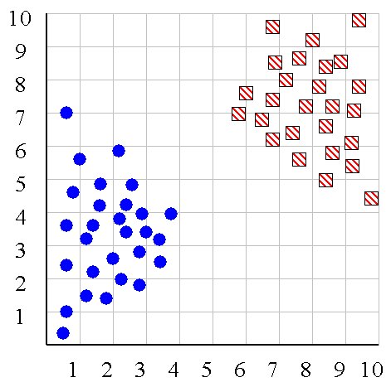
Single linkage
Average linkage
Wards linkage

Slide 17
Summary of Hierarchal Clustering Methods
No need to specify the number of clusters in advance.
Hierarchal nature maps nicely onto human intuition for some domains
They do not scale well: time complexity of at least O(n²), where n is the number of total objects.
Like any heuristic search algorithms, local optima are a problem.
Interpretation of results is (very) subjective.

Slide 18








Partitional Clustering
Nonhierarchical, each instance is placed in exactly one of K nonoverlapping clusters.
Since only one set of clusters is output, the user normally has to input the desired number of clusters K.

Slide 19
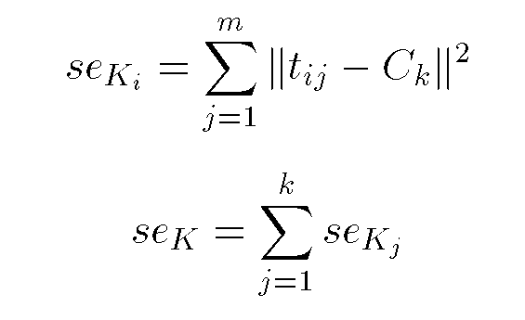
Squared Error
10
9
8
7
6
5
4
3
2
1
1
2
3
4
5
6
7
8
9
10
Objective Function

Slide 20
Algorithm k-means
1. Decide on a value for k.
2. Initialize the k cluster centers (randomly, if necessary).
3. Decide the class memberships of the N objects by assigning them to the nearest cluster center.
4. Re-estimate the k cluster centers, by assuming the memberships found above are correct.
5. If none of the N objects changed membership in the last iteration, exit. Otherwise goto 3.

Slide 21
K-means Clustering: Step 1
Algorithm: k-means, Distance Metric: Euclidean Distance
5
4
k₁
3
k₂
2
1
k₃
0
0
1
2
3
4
5

Slide 22
K-means Clustering: Step 2
Algorithm: k-means, Distance Metric: Euclidean Distance
5
4
k₁
3
k₂
2
1
k₃
0
0
1
2
3
4
5

Slide 23
K-means Clustering: Step 3
Algorithm: k-means, Distance Metric: Euclidean Distance
5
4
k₁
3
2
k₃
1
k₂
0
0
1
2
3
4
5

Slide 24
K-means Clustering: Step 4
Algorithm: k-means, Distance Metric: Euclidean Distance
5
4
k₁
3
2
k₃
1
k₂
0
0
1
2
3
4
5

Slide 25
K-means Clustering: Step 5
Algorithm: k-means, Distance Metric: Euclidean Distance
k₁
k₂
k₃

Slide 26
Comments on the K-Means Method
Strength
Relatively efficient: O(tkn), where n is # objects, k is # clusters, and t is # iterations. Normally, k, t << n.
Often terminates at a local optimum. The global optimum may be found using techniques such as: deterministic annealing and genetic algorithms
Weakness
Applicable only when mean is defined, then what about categorical data?
Need to specify k, the number of clusters, in advance
Unable to handle noisy data and outliers
Not suitable to discover clusters with non-convex shapes

Slide 27
The K-Medoids Clustering Method
Find representative objects, called medoids, in clusters
PAM (Partitioning Around Medoids, 1987)
starts from an initial set of medoids and iteratively replaces one of the medoids by one of the non-medoids if it improves the total distance of the resulting clustering
PAM works effectively for small data sets, but does not scale well for large data sets

Slide 28
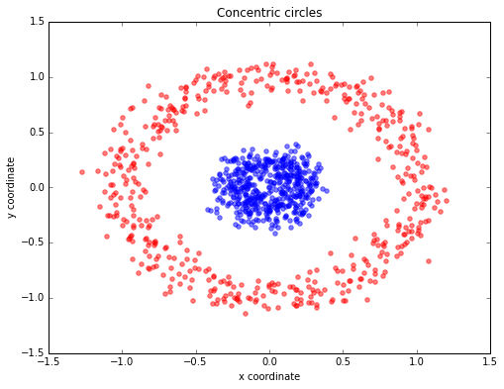
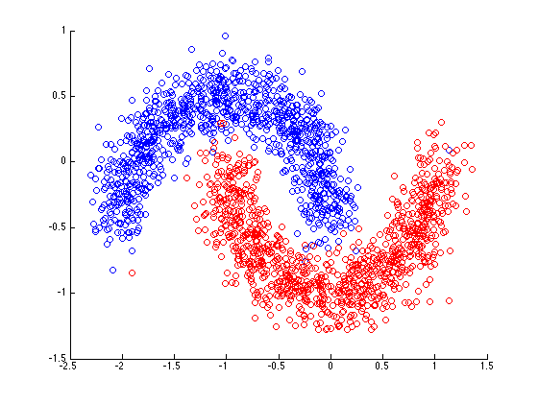
What if the data are not compact?

Slide 29
Spectral Clustering
Algorithms that cluster points using eigenvectors of matrices derived from the data
Obtain data representation in the low-dimensional space that can be easily clustered
Variety of methods that use the eigenvectors differently
Difficult to understand….

Slide 30
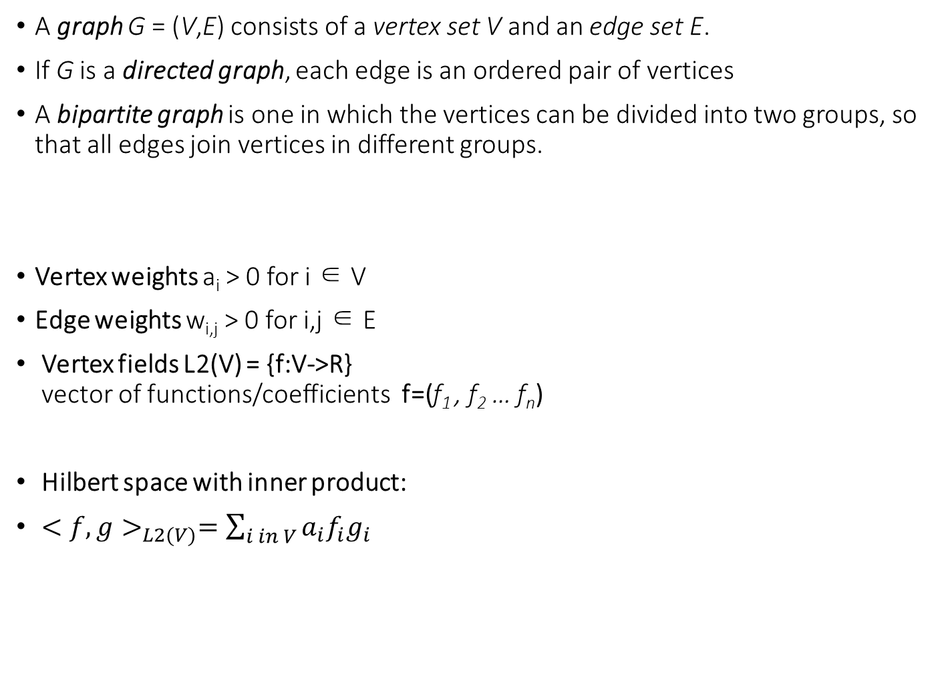
Elements of Graph Theory
A graph G = (V,E) consists of a vertex set V and an edge set E.
If G is a directed graph, each edge is an ordered pair of vertices
A bipartite graph is one in which the vertices can be divided into two groups, so that all edges join vertices in different groups.
Vertex weights a_{i} > 0 for i ∈ V
Edge weights w_{i,j} > 0 for i,j ∈ E
Vertex fields L2(V) = {f:V->R} vector of functions/coefficients f=(f₁ , f₂ … f_{n})
Hilbert space with inner product:
$<f,g>_{L2(V)}=\sum_{i in V}{a_{i}f_{i}g_{i}}$

Slide 31

Graph Calculus
Gradient: L2(V)->L2(E)
$(∇{f)}_{ij}=\sqrt{w_{ij}(f_{i}−f_{j})}$
Divergence L2(E)->L2(V)
$div{\left(F\right)}_{i}=\frac{1}{a_{i}}\sum_{\left(i,j\right)∈E}{\sqrt{w_{ij}} (F_{ij}−F_{ji})}$
Divergence and gradient are adjoint operators
f_{i}
F_{ij}
f_{j}

Slide 32

Graph Calculus
Gradient: L2(V)->L2(E)
$(∇{f)}_{ij}=\sqrt{w_{ij }}(f_{i}−f_{j})$
Divergence L2(E)->L2(V)
$div{\left(F\right)}_{i}=\frac{1}{a_{i}}\sum_{\left(i,j\right)∈E}{\sqrt{w_{ij}} (F_{ij}−F_{ji})}$
Divergence and gradient are adjoint operators
Laplacian operator L2(V)->L2(V)
f_{i}
F_{ij}
f_{j}

Slide 33

Laplacians
The laplacian is the analogous of II order derivatives
Represented as matrix algebra positive definite matrix L of size nxn
n is the number of vertices
W=(w_{ij}) A= ($\frac{1}{a_{i}}$) D=diag($\sum_{i≠j}{w_{ij}})$
W adiacency matrix D degree matrix
Unormalized Laplacian A=I
Random Walk Laplacian A=D
f_{i}
F_{ij}
f_{j}

Slide 34
Laplacians
The laplacian L admits n eigenvalues and eigenvectors
Eigenvectors are real and orthonormal (self adjointness)
Eigenvalues are real and non-negative (positive semidefinite matrix)

Slide 35

Energy of a graph
Dirichlet energy -> measure the smoothness of a function
On a graph given a function f of vertices
In matrix vector notation
Derivation make use of
$(∇{f)}_{ij}=\sqrt{w_{ij}}(f_{i}−f_{j})$

Slide 36
Smoothest orthobasis of a graph
Find a set of orthonormal vectors such that E_Dir is minimum
What does it mean?
It means find the set of vertices of the graph corresponding to a minimum in the smoothness function
That is -> set of vertices that in terms of edge weights are close together
Order of the vectors is proportional to the closeness
Solution

Slide 37
Smoothest orthobasis of a graph
Solutions are the first n eigenvectors of graph Lapalcian
The energy value is the sum of eigenvalues
Visually

Slide 38

How to cluster using graphs
Similarity Graph
Given a Dataset D of N elements in R^{d}
Points are graph vertices V={1….N }
Edges are similarities between points $w_{ij}=f(V_{i},V_{j})$
With f chosen similarity function
D₁
D₂
0.1
0.8
1
5
0.8
0.8
0.6
6
2
4
0.7
0.8
0.2
3

Slide 39
Graph partitioning
BI-Partition of a graph
Obtain two set of vertices that are disjoint
Remove all edges that connect the sets (CUT)
A
B
0.1
0.8
1
5
0.8
0.8
0.6
6
2
4
0.7
0.8
0.2
3
cut(A,B) = 0.3

Slide 40
Clustering Objectives
Traditional definition of a “good” clustering:
Points assigned to same cluster should be highly similar.
Points assigned to different clusters should be highly dissimilar.
2 Objective Functions:
Minimize the cut value -> Minimum cut
Find the minimum cut balancing the number of items per cluster -> Normalized cut (Shi Malik 1997)
Where vol(A) is the sum of edges inside set A
min cut(A,B)

Slide 41
Graph Cut Criteria
Criterion: Minimum-cut
Minimise weight of connections between groups
min cut(A,B)
Degenerate case:
Optimal cut
Minimum cut
Problem:
Only considers external cluster connections
Does not consider internal cluster density

Slide 42

Find An Optimal Min-Cut (Hall’70, Fiedler’73)
Objective MIN CUT can be formulated in matrix notation
Express a bi-partition (A,B) as a vector p
$$p=\left\{\begin{matrix}+1 iff D_{i}∈A \\ −1 iff D_{i}∈B\end{matrix}\right\}$$
$$mincut\left(A,B\right)={argmin}_{p}\sum_{V}{w_{ij}{\left(p_{i}−p_{j}\right)}^{2} }$$
Using
$$mincut\left(A,B\right)={argmin}_{p}p^{′}L p$$
Proof:

Slide 43
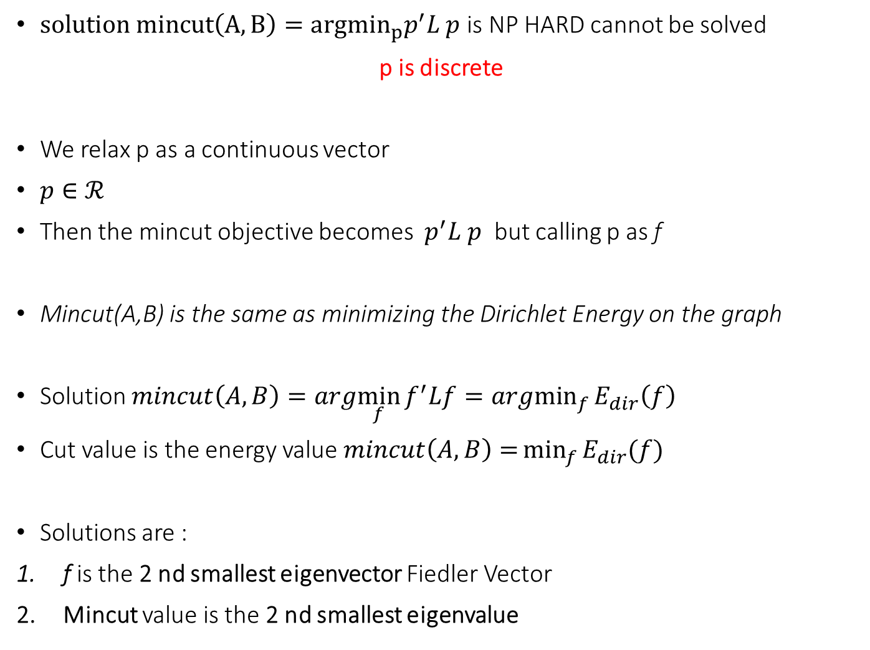
Find An Optimal Min-Cut 2 (Rayleigh Theorem revisited)
$solution mincut\left(A,B\right)={argmin}_{p}p^{′}L p$ is NP HARD cannot be solved
p is discrete
We relax p as a continuous vector
$p∈ℛ$
Then the mincut objective becomes $p^{′}L p$ but calling p as f
Mincut(A,B) is the same as minimizing the Dirichlet Energy on the graph
Solution $mincut\left(A,B\right)=arg\min_{f}{f^{′}Lf=\underset{f}{argmin}{E_{dir}\left(f\right)}}$
Cut value is the energy value $mincut\left(A,B\right)={\min_{f}{E_{dir}(f)}}$
Solutions are :
f is the 2 nd smallest eigenvector Fiedler Vector
Mincut value is the 2 nd smallest eigenvalue

Slide 44
Spectral Clustering Procedure
Three basic stages:
Pre-processing
Construct a matrix representation of the dataset.
Decomposition
Compute eigenvalues and eigenvectors of the matrix.
Map each point to a lower-dimensional representation based on one or more eigenvectors.
Grouping
Assign points to two or more clusters, based on the new representation.

Slide 45
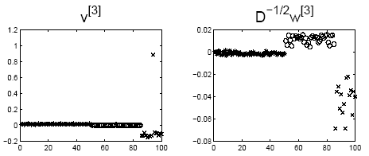
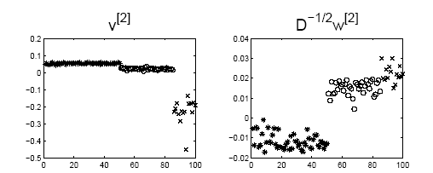
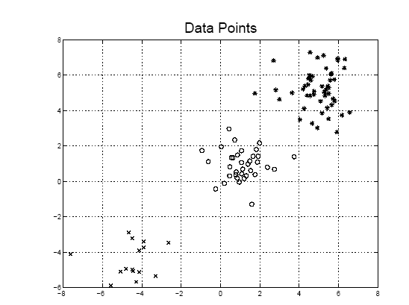
3-Clusters
If we use the 2nd eigen vector
If we use the 3rd eigen vector

Slide 46
K-Way Spectral Clustering
How do we partition a graph into k clusters?
Two basic approaches:
Recursive bi-partitioning (Hagen et al.,’91) Recursively apply bi-partitioning algorithm in a hierarchical divisive manner. Disadvantages: Inefficient, unstable
Cluster multiple eigenvectors (Shi & Malik,’00) Build a reduced space from multiple eigenvectors. Commonly used in recent papers A preferable approach…but its like to do PCA and then k-means

Slide 47
Cluster multiple eigenvectors
K-eigenvector Algorithm (Ng et al.,’01)
Pre-processing Construct the scaled adjacency matrix
Decomposition Find the eigenvalues and eigenvectors of L. Build embedded space from the eigenvectors corresponding to the k smallest eigenvalues
Grouping Apply K-Means to reduced n x k space to produce k clusters.

Slide 48

How to select K spectral gap Heuristic
Eigengap: the difference between two consecutive eigenvalues.
Most stable clustering is generally given by the value k that maximises the expression
$∆_{k}=\left|λ_{k}−λ_{k−1}\right|$
Largest eigenvalues
of Cisi/Medline data
λ₁
λ₂

Slide 49
Conclusion
Clustering as a graph partitioning problem
Quality of a partition can be determined using graph cut criteria.
Identifying an optimal partition is NP-hard.
Spectral clustering techniques
Efficient approach to calculate near-optimal bi-partitions and k-way partitions.
Based on well-known cut criteria and strong theoretical background.
Read: “A Tutorial on Spectral Clustering” V.Luxburg Aug 2006

